Slide 1
Apple in China & India
Group 3: Sara Haynes, Chelsea Taxter, Amia Diakite, Jaewoo Cho, William Chen

Slide 2
Overview in China
Apple launched the iPhone in China in 2009, two years after they launched it in the US
By 2019, Apple was losing to its local competitors (Huawei, Xiaomi, and Oppo) because they offered less features at a higher price
“Chinese consumers were generally more price sensitive than US consumers.”
In 2018, Apple decided to offer a higher-end product, but their market share continued to shrink despite slightly rising revenues
User Experience, Price, and CPC all play a crucial role in why Apple’s market share was sinking in China

Slide 3
China & User Experience
A large reason so many people buy and trust Apple products is because of its brand.
At the core of Apple’s brand is their user experience, and it wouldn’t be worth sacrificing that for consumers who want products at a lower price.
Although higher priced products might scare off some consumers, it does still lead to higher revenues and allows Apple to stay true to their brand.

Slide 4

China & Price
Lowering prices would decrease profit margins, increase demands for lower prices in other countries, and potentially make Apple lose its “prestigious” title
Potential increased market share
Apple failed to attract Chinese consumers with the iPhone 5C and the iPhone SE
Competitors, like Xiaomi, offered smartphones as low as $100
Notes:
William

Slide 5
China & Customer Purchase Criteria (CPC)
Apple faces a conflict between their brand principles and the usefulness of their products for Chinese consumers
Chinese Consumer Needs
A product with features to support video streaming and popular services such as WeChat sold for a reasonable price
Apple Philosophy
Core products with minor variations reflect Steve Jobs belief that “all Apple customers should have the highest level of user experience.”
Creating a completely new product adhering to CPC of Chinese consumers would part away from Apple’s brand philosophy in user experience. Rather, a larger focus in variations that support Chinese CPCs could potentially increase value of current Apple products.
Notes:
Should Apple create a new product to meet the specific CPC of Chinese consumers, and do this better than local rivals?

Slide 6
Overview in India
The Indian smartphone market which had a large growth expectancy in 2019 did just that but was at a much earlier stage of development than the Chinese smartphone market.
Number of smartphones was expected to grow at a 9.2% annual rate from 340 million in 2019 to 442.5 million in 2022.
The Indian smartphone market was price sensitive with smartphones selling at an average price of $158. More than half of smartphone shipments to India were of devices in the $100-$200 range.
Despite entering India as early as 2008 and anticipating being there for “thousands of years” , Apple fell short of its goals and did not deliver a smartphone product that appealed to enough customers and was thwarted by more effective competitors and government interference.

Slide 7
India & Competitors
All competitors gained market share by selling their smartphones for less than $200:
In 2018 Xiaomi led the Indian smartphone market with 27.3% share followed by Samsung with 22.6% while Viva’s share increased to over 10%.
In 2018 Apple in India achieved only 1.8 billion in revenues, which was less than half of the company’s goal for the year
India appeared to be a large market with untapped potential due to the ownership of smartphones growing at a rapid rate, however Apple proved to be an ineffective competitor there. Apple set prices out of reach for what most customers, about twice what customer were willing to pay. Over 70% of the smartphones in India cost less than $250.
How should Apple improve its competitive performance in India? Could Apple compete against low-cost imports from China? How?
Giving consumer what they want:
Lowering smartphone prices to meet selling patterns
Improving battery performance- customers often worked long days away from electrical outlets
Improving Apple Maps- the current Indian version offered spared mapping data of cities and often missed landmarks

Slide 8
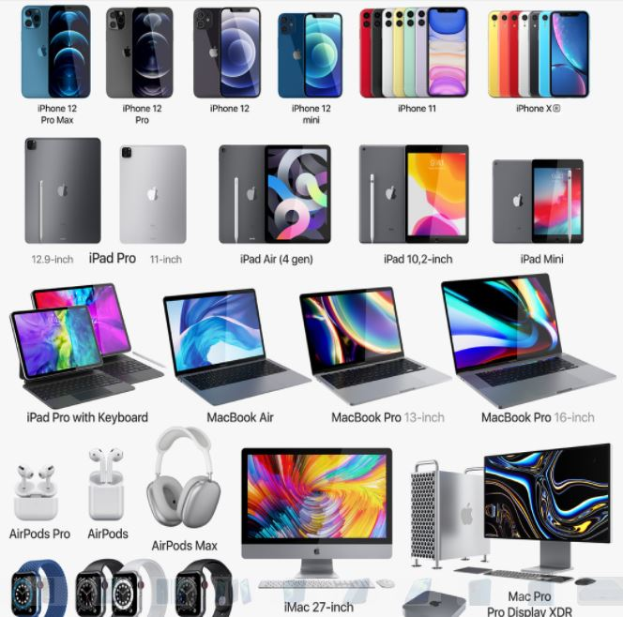
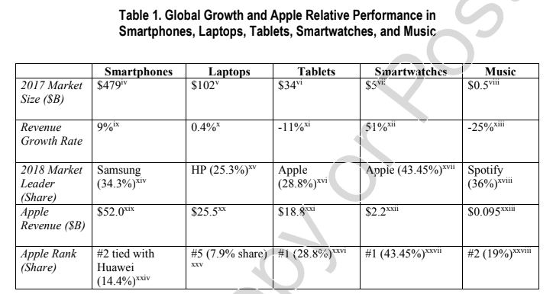
India & Tariffs
Should Apple manufacture iPhones in India to relieve itself of tariff burdens and boost its distribution flexibility?
Tariff : A tax on imported goods and services from foreign countries
Notes:
https://www.economicshelp.org/blog/glossary/tariffs/
https://www.reviewecon.com/trade-tariffs
https://medium.com/@MarkJPerry/an-economic-analysis-of-protectionism-clearly-shows-that-trumps-tariffs-would-make-us-poorer-not-ee83d55a12d9
https://www.redwoodlogistics.com/as-the-import-tariffs-grow-how-is-domestic-shipping-affected/

Slide 9
India & Tariffs: Decision Matrix
1: Manufacture iPhones outside of India | 2: Manufacture iPhones in India
Advantages | Advantages
Low Risk of failure Consistent manufacture operations | Relieve Tariff Burdens Boost Global manufacture Distribution Potential growth in a new region - IT
Disadvantages | Disadvantages
Profit reductions due to tariff burdens Limited growth potential Restricted global distribution | High Initial implementation costs Slow rate of growth/profit
Notes:
https://www.economicshelp.org/blog/glossary/tariffs/
https://www.reviewecon.com/trade-tariffs
https://medium.com/@MarkJPerry/an-economic-analysis-of-protectionism-clearly-shows-that-trumps-tariffs-would-make-us-poorer-not-ee83d55a12d9
https://www.redwoodlogistics.com/as-the-import-tariffs-grow-how-is-domestic-shipping-affected/

Slide 10
India & Customer Purchase Criteria (CPC)
“Apple’s low market share was due to the mismatch between what Indian smartphone consumers wanted and what Apple provided.”
iPhone prices too high
Unsupportive battery life for lifestyle
Issues with Apple Map and Siri
Poor experiences with Apple’s after-sales services
Lack of established Apple stores in India
To address price concerns, Apple proposed to sell refurbished versions of used iPhones for a much lower cost. Cost, however, was only one of many CPC concerns.
CPC could potentially be addressed if Apple invests in quality development for supporting services within and around Apple products in India.

Slide 11
Questions?
Thank you!

